Slide 1
SC1015
Mini Project
Z136 Team 4
Chong Choy Jun
Chew Di Heng
Choh Lit Han Owen

Slide 2
Introduction
Ford car price dataset from kaggle
Problem Definition
Dataset
As COE in Singapore have been rising rapidly, how can one choose the most appropriate car model that will be value for money ?
Are we able to predict car price through a subset of the car features alone? Does the engine size affects the price more than model?

Slide 3
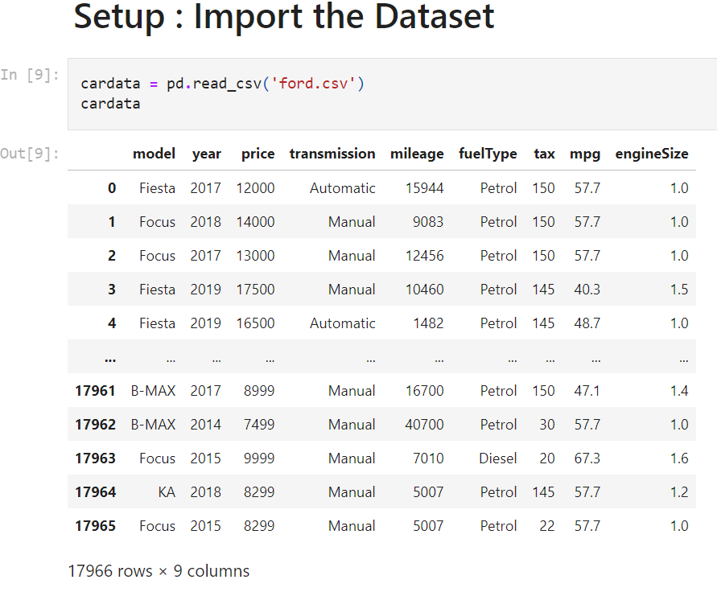
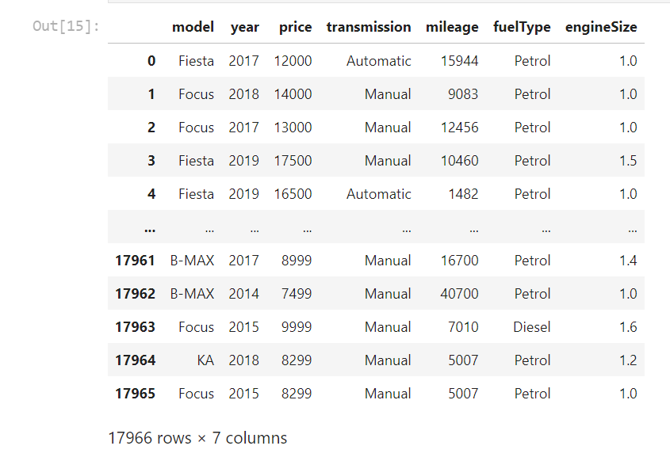
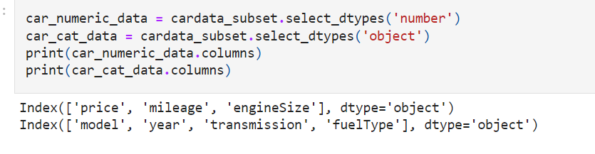
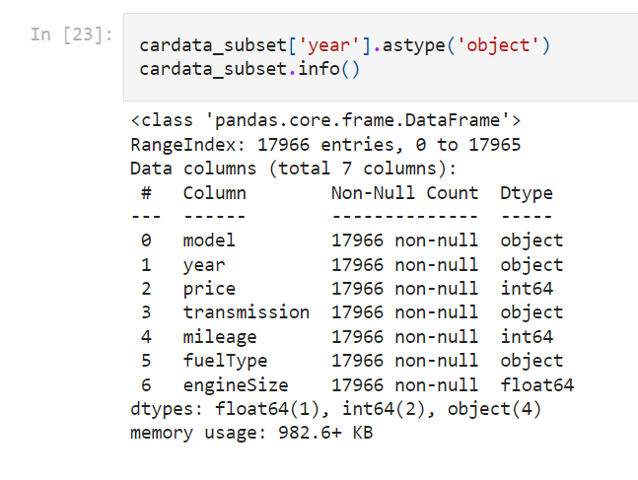
Data Cleaning and Preparation
Before
After
After
Drop
Tax
Miles Per Gallon
Change “Year” to object type
We change “Year” to object type
Splitting data set into numerical data and categorical data

Slide 4
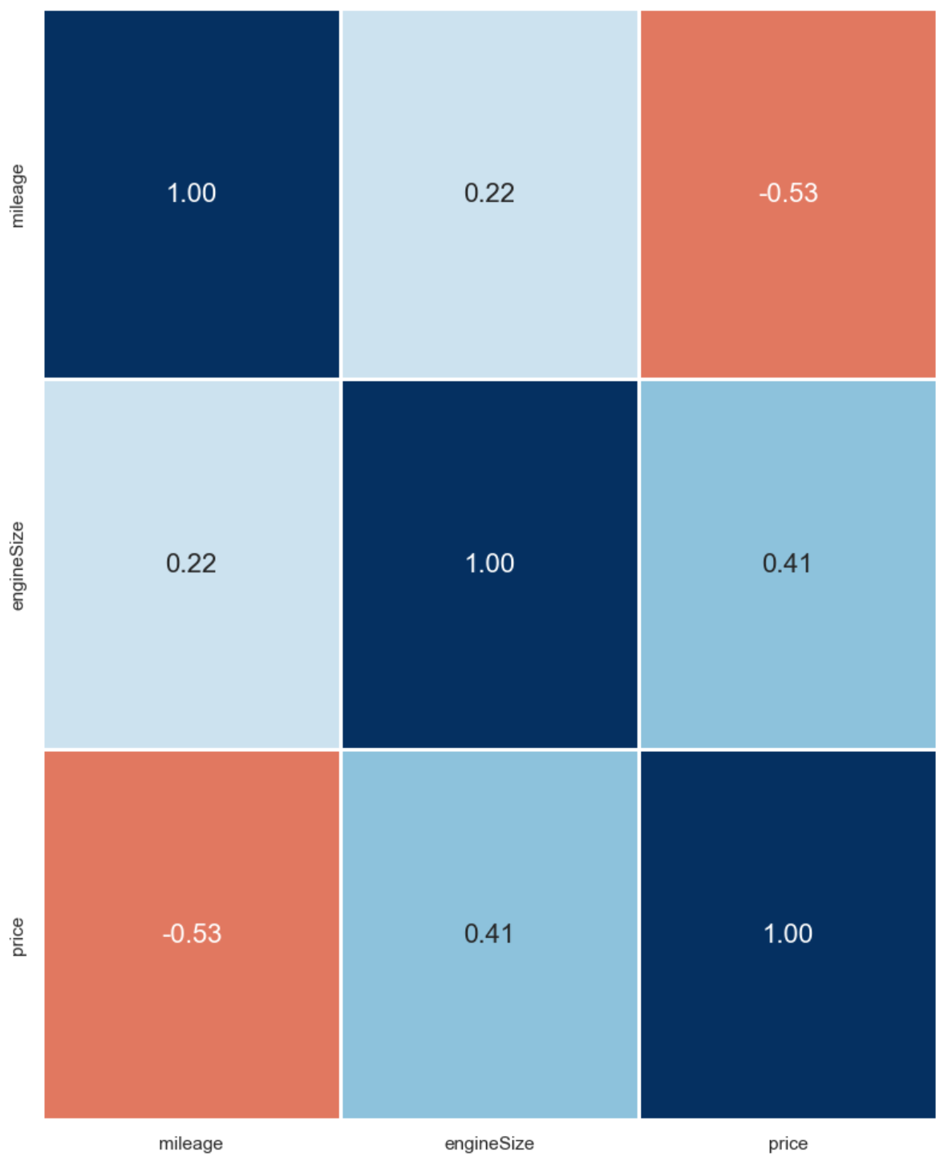
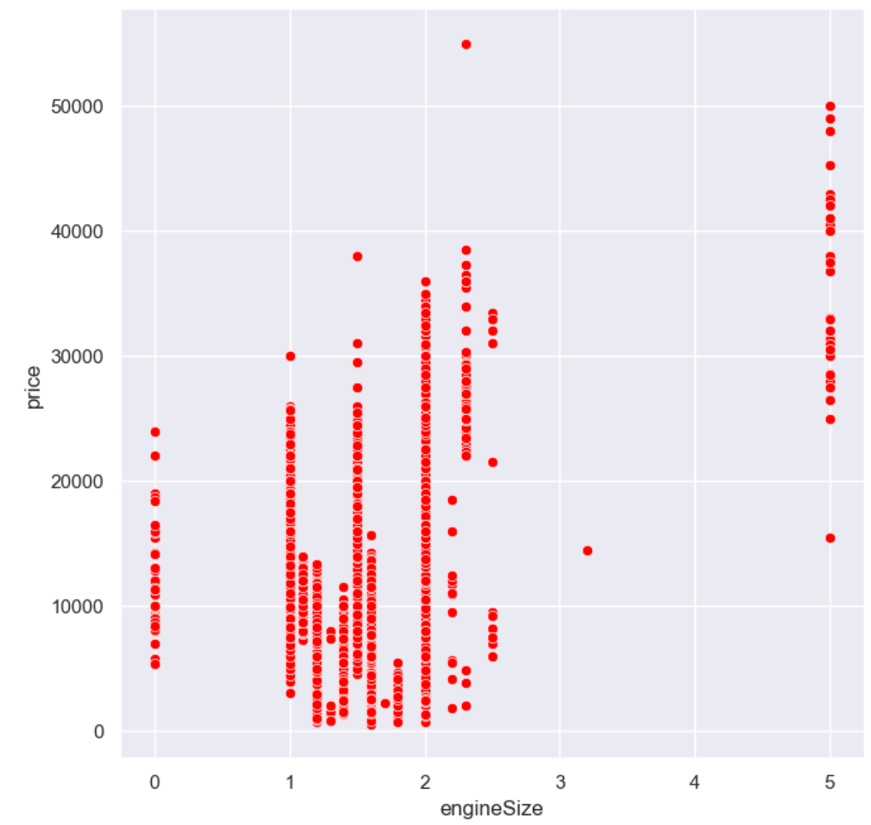
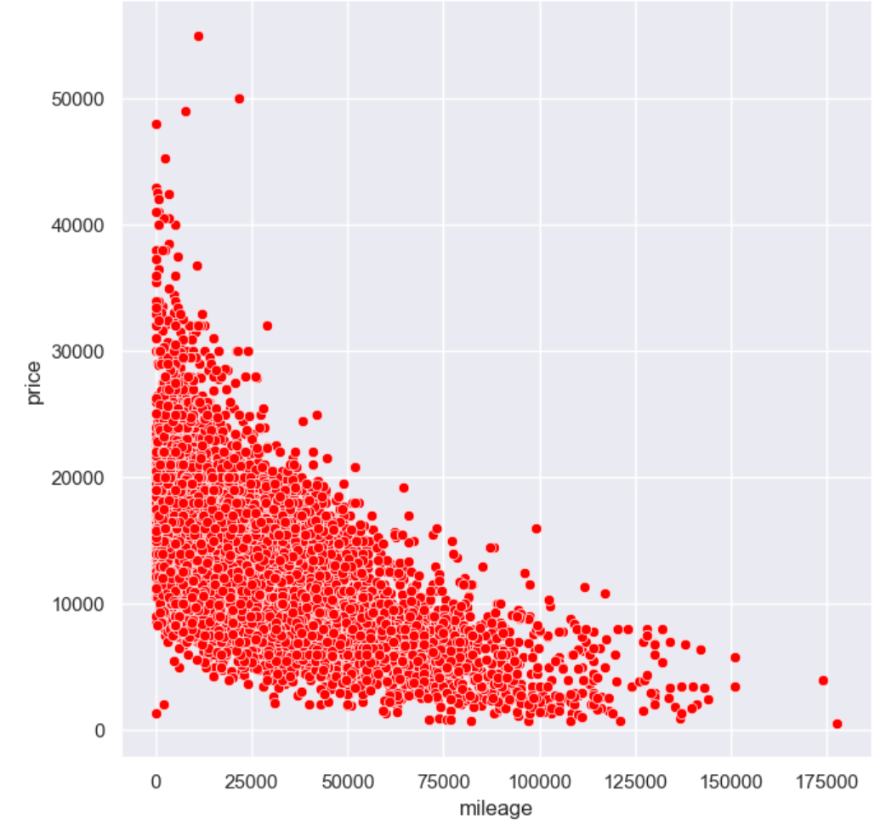
Exploratory Data Analysis - Numerical data
Correlation Matrix
Engine Size
Mileage
Mileage has a stronger correlation with price
Size “5” > 20000
Mileage < 25000 attracts high price

Slide 5
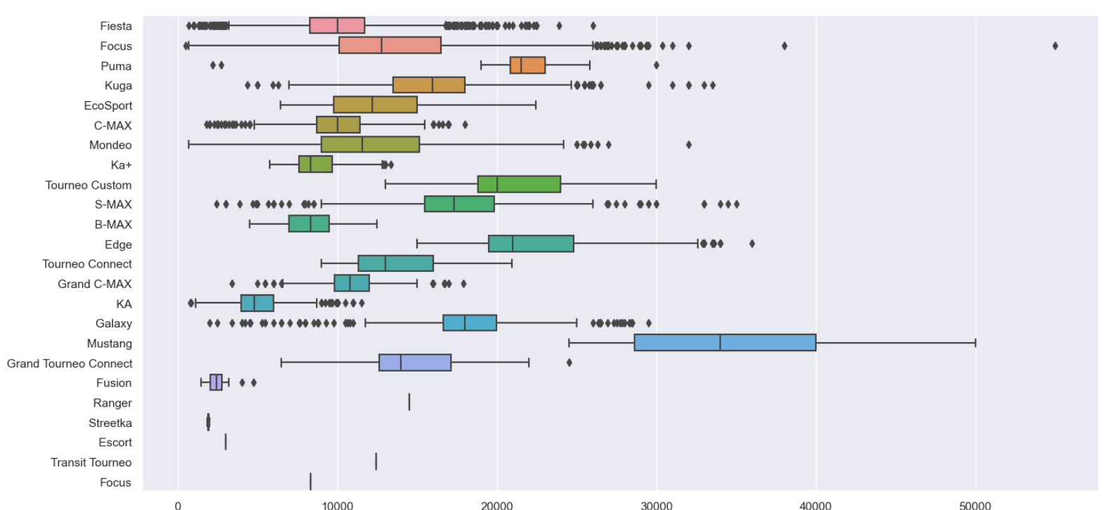
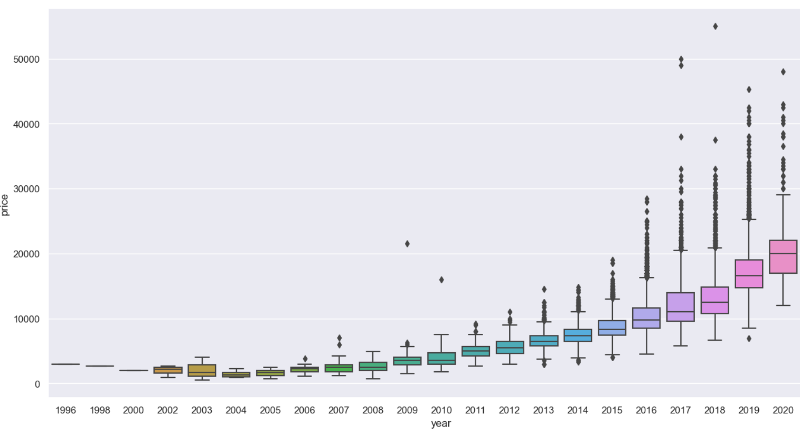
Exploratory Data Analysis - Categorical Data
Model
Year
Model “Focus” have outliers reaching > 50000 in price
Newer car model in general have higher selling price

Slide 6
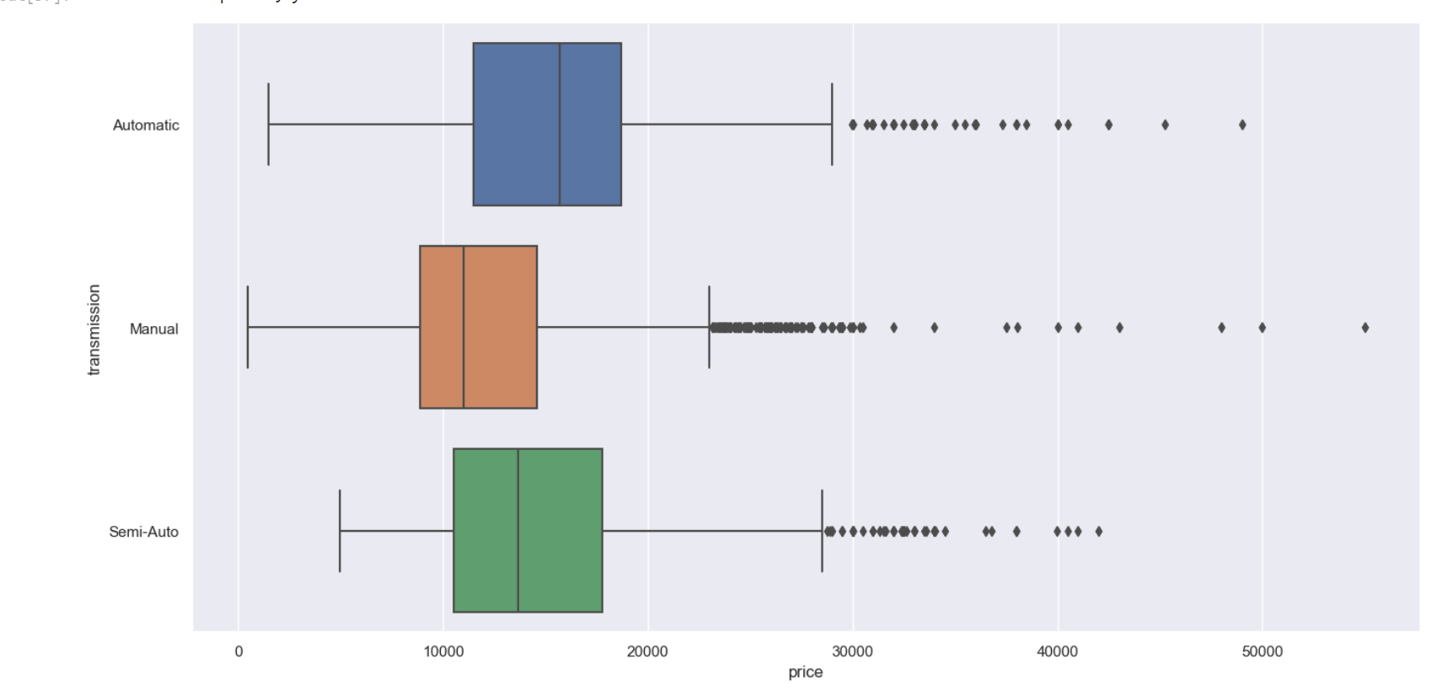
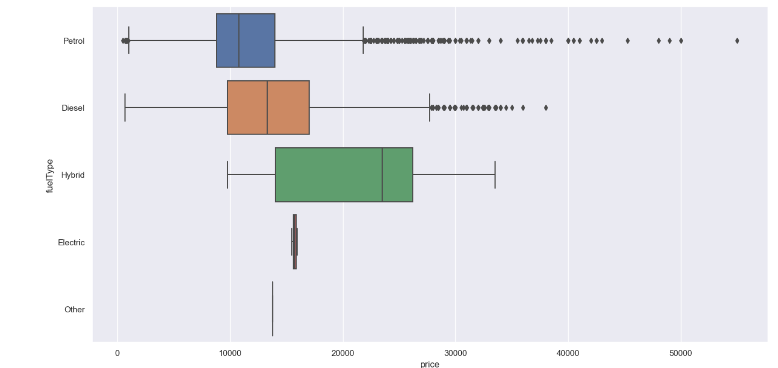
Exploratory Data Analysis - Categorical Data part 2
Transmission
Fuel Type
Manual car attracts higher price
Petrol car attract higher price

Slide 7
Why Random Forest
Random Forest
Machine learning technique
Components
Advantage
Consists of
Function
Reduces
Maintain
Multiple decision trees
Perform regression
Risk of bias and overfitting
Accuracy
Notes:
One of the models that we used is random forest which is
A machine learning technique that uses multiple decision trees
to perform regression in our project
We use it as it reduces the risk of bias and overfitting onto the dataset
while still maintaining accuracy

Slide 8
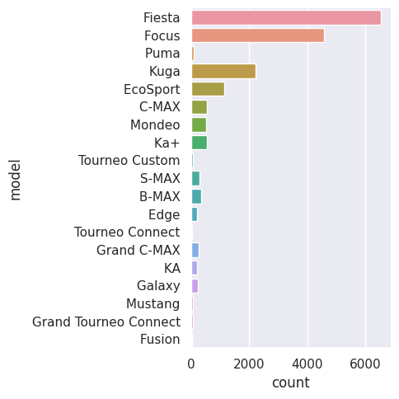
Model: Random Forest
How we applied it
01
02
03
OHE
Build Model
SMOTE
One Hot Encoded (OHE) categorical variables
Fit the model on the dataset
Used SMOTE to rebalance the dataset
Notes:
In order to apply this model, we first used one hot encoding
To convert the categorical data into a more usable format
Then we trained the model on that dataset
And finally learnt to use SMOTE to oversample the minority class within the car models
as it is fairly skewed

Slide 9
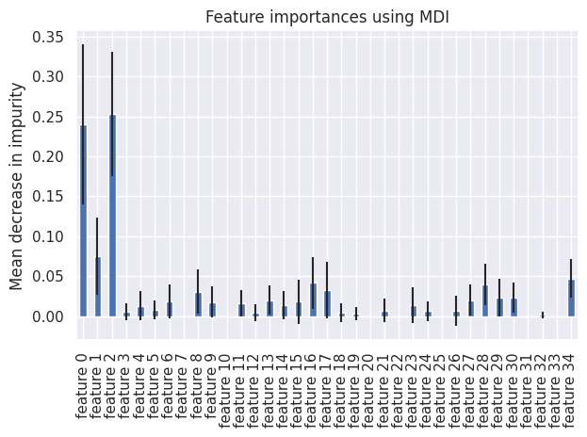
Results of the Model
04
05
06
All features
Omit features
After SMOTE
R^2 score of 0.719
R^2 score of 0.681
R^2 score of 0.485
Notes:
The results of our work is as shown here
After training the first model on the one hot encoded dataset
It has a high R square score of 0.719
Then we also looked at the feature importance generated by the model in the graph above
The highest two bars are mileage and year of the car
also the features 3 to 26 are for the each model of the car and their sum is also high
So using the top 3 important features, we trained the model again
and the r square score is very similar at 0.681
which means these features are as sufficient in predicting the price of cars
as when using the entire dataset
After checking this feature importance,
we also used SMOTE to balance the distribution of the car models
and the result of the model decreased to 0.485
This is likely because of the model being more biased towards the minority class
And also due to the high degree of oversampling required
On top of the large number of artificial data points extrapolated
As many of the car models are less than 5% of the majority
Causing the technique to increase the dataset from
about 18 thousand values to over 124 thousand values

Slide 10
Key Learning Points: Random Forest
1
Flexible Model
Applicable to both regression and classification problems
2
Advantage
Avoids overfitting
3
SMOTE
Good for increasing minority class but may decrease performance of model
Notes:
These are the key things that we learnt while attempting to build the random forest model
We learnt that the
Random forest is a very flexible model as
it can perform both regression and classification tasks
By averaging the results from the decision trees or by using a majority vote respectively
The other thing we learnt about the random forest is that
it helps to avoid overfitting the dataset
Since it uses averaging of results from uncorrelated decision trees
And finally while using SMOTE to try to improve model performance
We learnt that even though it allows us
to increase the representation of minority classes,
It may not always help improve performance
And now i will pass the time to choy jun to explain the next model used in our project

Slide 11

Model: Decision Tree Classifier
Easy to interpret and visualize
Handles both categorical and numerical data
Interpretable
Versatile
Decision
Tree
Can be used for feature selection
Can be combined with other algorithms
(K-Fold)
Feature Selection
Compatible with others
Notes:
Thank You owen,
We decided to use decision tree classifier.
One reason of using a decision tree classifier it is simple and easy to understand.
Decision tree is versatile as it could handle both categorical and numerical data. As our dataset contains these 2 type of data it will be a good choice to use DT
Another reason we choose to use DT is that DT is compatible with other algorithms such as k-fold to improve its performance.

Slide 12
Why K-Fold
Provides a more accurate estimate of the model's performance
Enables more efficient use of data
Reduces the risk of overfitting
Help with model selection
Notes:
Why did we choose to add K-fold?
Provides a more accurate estimate of the model performance and enables more efficient use of data.
It also help with model selection and most importantly it reduces the risk of overfitting.
We fear that using DT itself might cause the model to overfit hence we decided to use k-fold to reduce it.

Slide 13
How we applied it?
01
OHE
One Hot Encoded (OHE) categorical variables
02
K-Fold
Split the dataset into 10 equally sized folds
03
Build Model
Fit model on to dataset
Notes:
we first used one hot encoding
To convert the categorical data into a more usable format
Then we use kfold to split the dataset into 10 equally sized folds
After that we fit the model on to the dataset
And we trained the model

Slide 14
Results of the model
Decision Tree
R^2
R^2 score of 0.636
DT + K-Fold
R^2
R^2 score of 0.607
Notes:
So here are the result.
Before using K-fold the result is 0.636. We found out that the model might be overfit and we use k-fold to reduce the overfitting
And the result seems good to us as we get a r2 score of 0.607.
Both results are looking average to us but we think that the performance could be better if we use another model.

Slide 15
Key Learning Points: Decision Tree Classifier
Pros
Cons
Popular and powerful
Tree-like model
Versatile
Prone to overfitting
Need to reduces overfitting
Is not suitable for our dataset
Notes:
Decision tree classifier is a popular and powerful machine learning algorithm that is widely used for both classification and regression tasks.
A decision tree is a tree-like model that represents a set of decisions and their possible consequences. Each node in the tree represents a decision or a feature, and each branch represents a possible outcome or a value of the feature.
Decision tree classifier works by recursively splitting the data into smaller subsets based on the most informative features, until a leaf node is reached
It can handle categorical and numerical data, and can be used for both binary and multi-class classification problems
However, decision tree classifier is prone to overfitting and in order to reduces overfitting, therefore we decided to use K-fold cross-validation to reduce it.

Slide 16
Key Learning Points: K-Fold
The R^2 score & accuracy decreases
Better Performance?
It managed to reduced overfitting
LICENSE
Reduces Overfitting
Using all of the data in each iteration
More Efficient
Notes:
By using K-Fold, we expect the performance of the model to increase. However, after using k-fold the performance seems to drop. A potential reason for it is the model is being trained on a smaller subset of the data in each fold.
However, we found out that using K-Fold did helped to reduce overfitting and it uses the data more efficiently as it will ensures that each example in the dataset is used for both training and testing, and that the model is evaluated on a diverse set of examples.
Overall, we think that using Decision Tree classifier is not the ideal model to solve our problem as the performance of it is not up to our standard.

Slide 17
Model: Gradient Boosting Regressor
01
02
Flexibility
High accuracy
Can be used for a variety of regression tasks
Known for producing highly accurate predictions
Notes:
can be used for a variety of regression tasks, including predicting house prices, stock prices, and sales forecasting, and can be applied to a wide range of datasets, including structured and unstructured data.

Slide 18
How did we applied the model?
1
OHE
One Hot Encoded (OHE) categorical variables
2
Split Dataset
Split into train and test
3
Build Model
Fit model on to dataset
Notes:
we first used one hot encoding
To convert the categorical data into a more usable format
Then split the dataset train dataset and test dataset
After that we fit the model on to the dataset
And we trained the model t

Slide 19
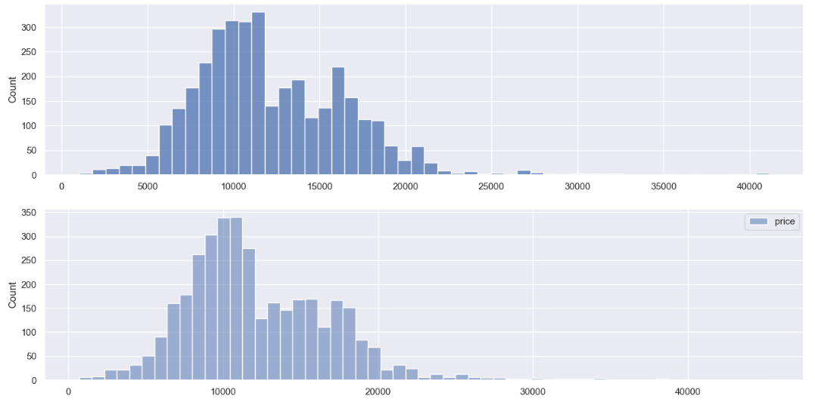
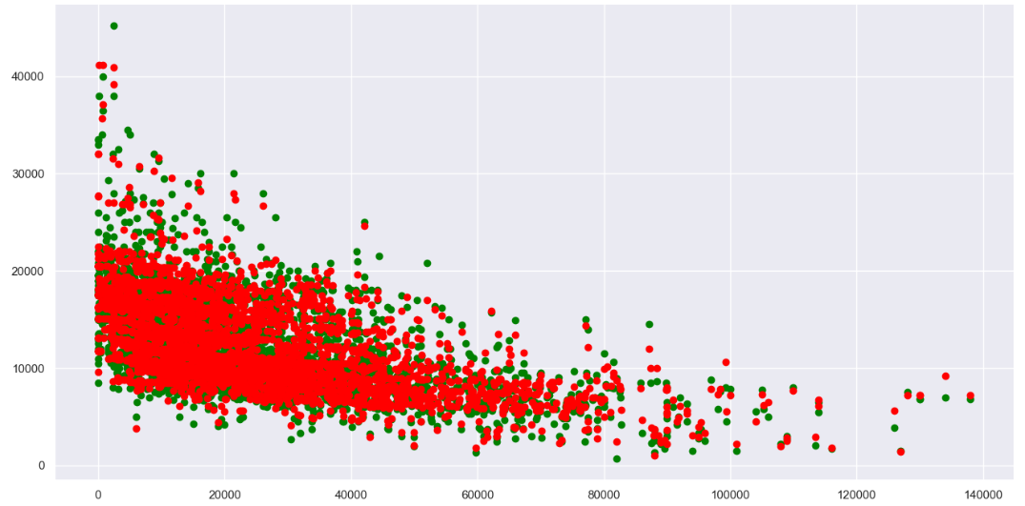
Model: Gradient Boosting Regressor
Train Dataset
Test Dataset
Accuracy of 0.91838
R^2 score of 0.91838
Accuracy of 0.92068
R^2 score of 0.92068
Results of the model
Notes:
Here are the results.
For the train dataset we get a R^2 score of 0.918
And test dataset we get a R^2 score of 0.92068
Both results are really good as compared to the other 2 models we used.
This means that the prediction of car prices based on the predictors is highly accurate.
We think that a regressor model is a more suitable model for our problem.

Slide 20
Key Learning Points: Gradient Boosting Regressor
Better Performance
Increase in accuracy & R^2 score
Flexible
Can capture complex non-linear relationships
Ensemble Method
Combines the predictions
Provide Insights
understanding the underlying relationships in the data.
Notes:
Gradient Boosting Regressor (GBR) is a machine learning algorithm that uses a collection of weak learners, typically decision trees, to make predictions.
by iteratively adding decision trees to the model, with each new tree fitting the residual errors of the previous tree.
It can handle both categorical and numerical features, and can capture complex non-linear relationships between the input features and target variable.
GBR can also be used for both regression and classification tasks, depending on the type of loss function used.
GBR combines the predictions of multiple weak learners to make a final prediction. This can improve the accuracy and robustness of the model, especially if the individual learners are diverse.
can provide insights into the importance of different features in the dataset, which can help with feature selection and understanding the underlying relationships in the data.

Slide 21
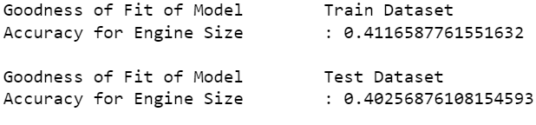
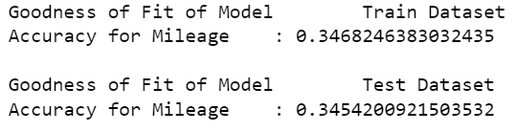
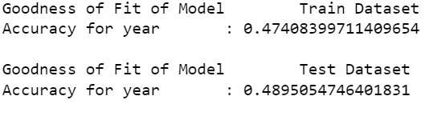
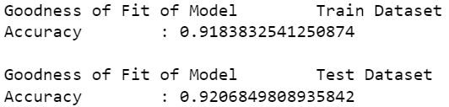
Gradient Boosting Regressor: Importance chart
Accuracy for Engine Size
Accuracy for Mileage
1
2
Accuracy for Year
Accuracy for all variables
3
4
Notes:
The model can provide us a feature importance chart, displaying how each variable can contributes to the predictor of car prices. In our sample, we found out that the accuracy for mileage is the lowest with a R^2 of 0.35. This could mean that mileage is not a good predictor for car prices. The accuracy for engine Size of 0.4, slightly higher than mileage. Lastly, we have 0.48 accuracy for year, and year is a better predictor among all categorical variables. With this chart, manufacturers, dealerships and buyers can better understand which features of the car have their individual impact on the car prices and make better informed choice.

Slide 22
Conclusion
Outcome of our project
01
02
03
Outcome
Insights
Recommendation
Gradient boosting regressor is the best performing model
Models can provide information about the features affecting price
“Out of sample testing”
Notes:
To conclude our project
Our first model, random forest, achieved an R-squared value of 0.719.
Our next model using KFold, achieved a lower R-squared value of 0.636.
Finally our last model, the gradient boosting regressor, achieved the highest R-squared value of 0.918 which indicates the best performer among the three.
In terms of data-driven insights,
the models can provide information about
the most important features that affect car prices.
For example, the gradient boosting regressor model
can provide a feature importance chart,
displaying how each feature contributes to the prediction of car prices.
This can allow buyers, car manufacturers and dealerships to understand
how each feature impacts the price of the car and make informed decisions.
For recommendations on how to improve,
it is important to note that these models alone
do not accurately solve the original problem of predicting car prices.
To ensure that the model is consistent,
we will need to test the model on new set of data
also known as "out of sample testing"
And that brings us to the end of our project, thank you

